Slide 1
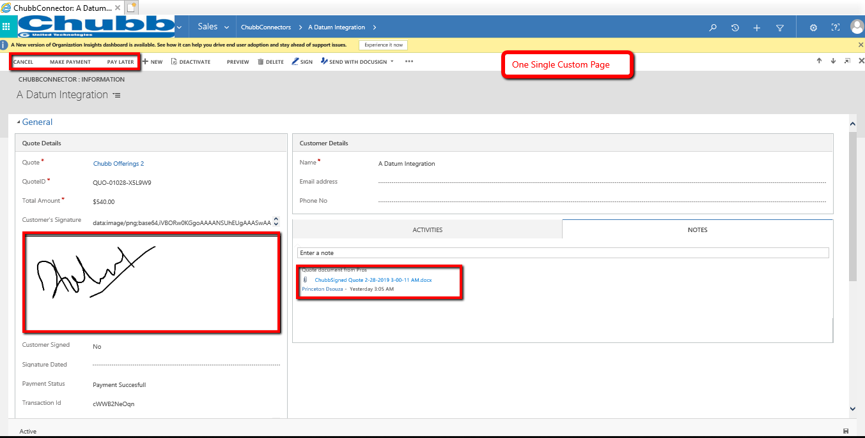
Actual build demoed during our Cadence meeting:
ONE PAGE custom solution developed by LTI based on the initial requirement. Chubb Connector custom form with 3 buttons i.e. Make payment, Pay later and Cancel along with generated Contract Agreement with an ability to take Client signatures on the same page via tablet.

Slide 2
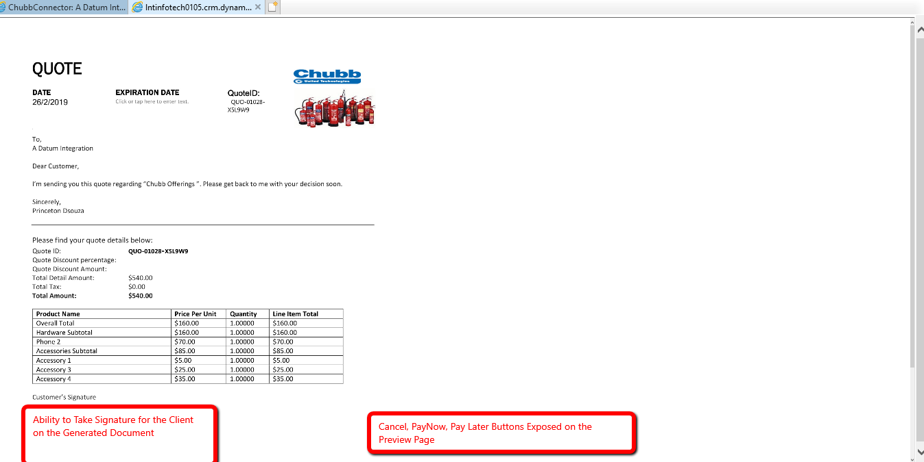
Customer want :
LTI is reviewing the possible ways to achieve this, however it seems client requires a functionality similar to DocuSign/ Adobe sign which is difficult to achieve.

Slide 3
DocuSign Alternatives…
E-Signatures | Price Plans | Column1 | Column2 | Column3
 | Small Business plan | Standard Plan/Professional plan | Advanced / Business Plan | Free Trial
PandaDoc |  | $19.99/month per user | $39.99/month per user | 14-days
DocuSign |  | $25/month per user | $40/month per user | 30-days
AdobeSign | $24.99/month per user |  | $39.99/month per user | 14-days
HelloSign |  | $13/month (allows upto 5 senders) | $40/month (allows upto 5 senders) | 30-days
eSign |  | $20/month per user | Works on individual basis based on volume
SignNow |  | $5/month per user | $15/month per user
SignEasy | $15/month | $10/month | $20/month (upto 3 user)
RightSignature |  | $12/month per user | $60/month (upto 3 users)
KeepSolidSign |  | $39.99/month (per 5 person) | $71.99/month (per 10 person) | 14-days
Signable | £19/month (upto 50 documents) | £1 per document | £149/month (upto 750 documents)
GetAccept |  | $35-40/month per user

